Slide 1

Hand Controlled Ball Levitation
Sameer Panghal, Suraj Patel, & Yuvraj Upadhyay
ME 4012 Modeling and Control of Motion Systems
Spring 2025 Final Project Presentation

Slide 2
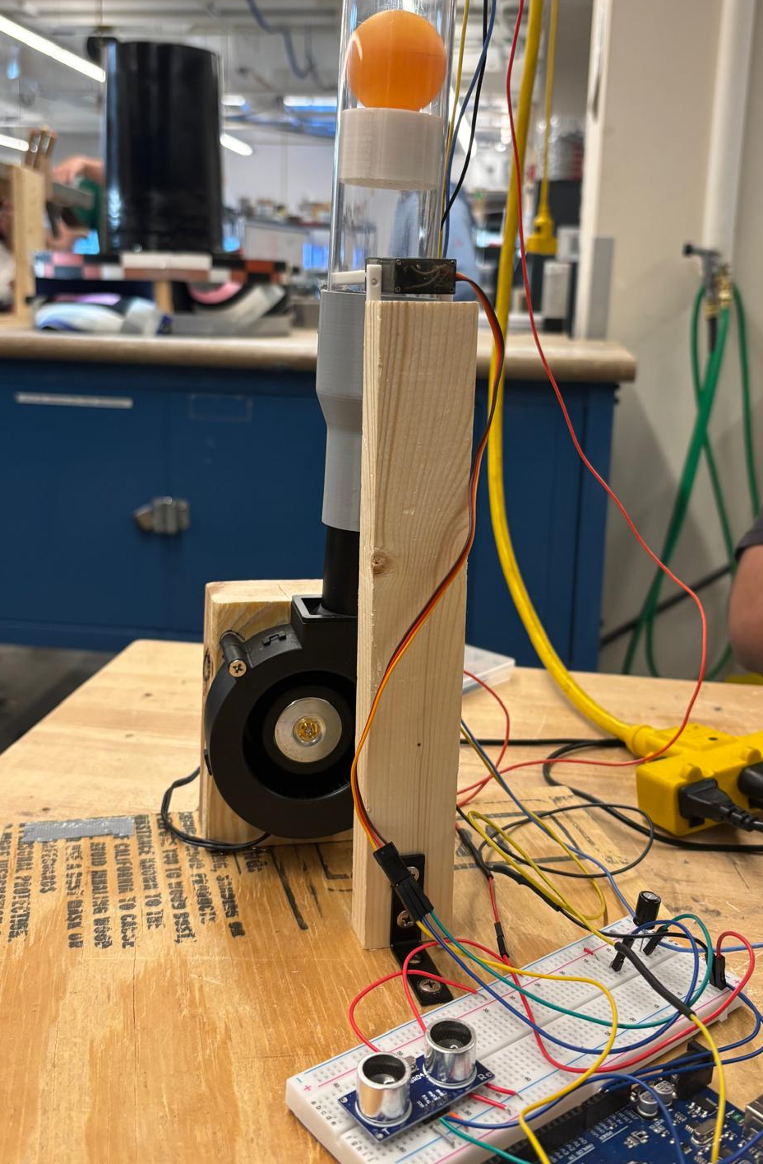
Motivation
Balancing a ball in a tube with a fan at full speed and a throttle to control air flow subject to variable input.
Implementing control into this system allows for height control – something not possible in the system’s natural state.
Applications: Controlling other nonlinear systems, levitation transport systems, thrust vectoring and altitude control, etc.

Slide 3
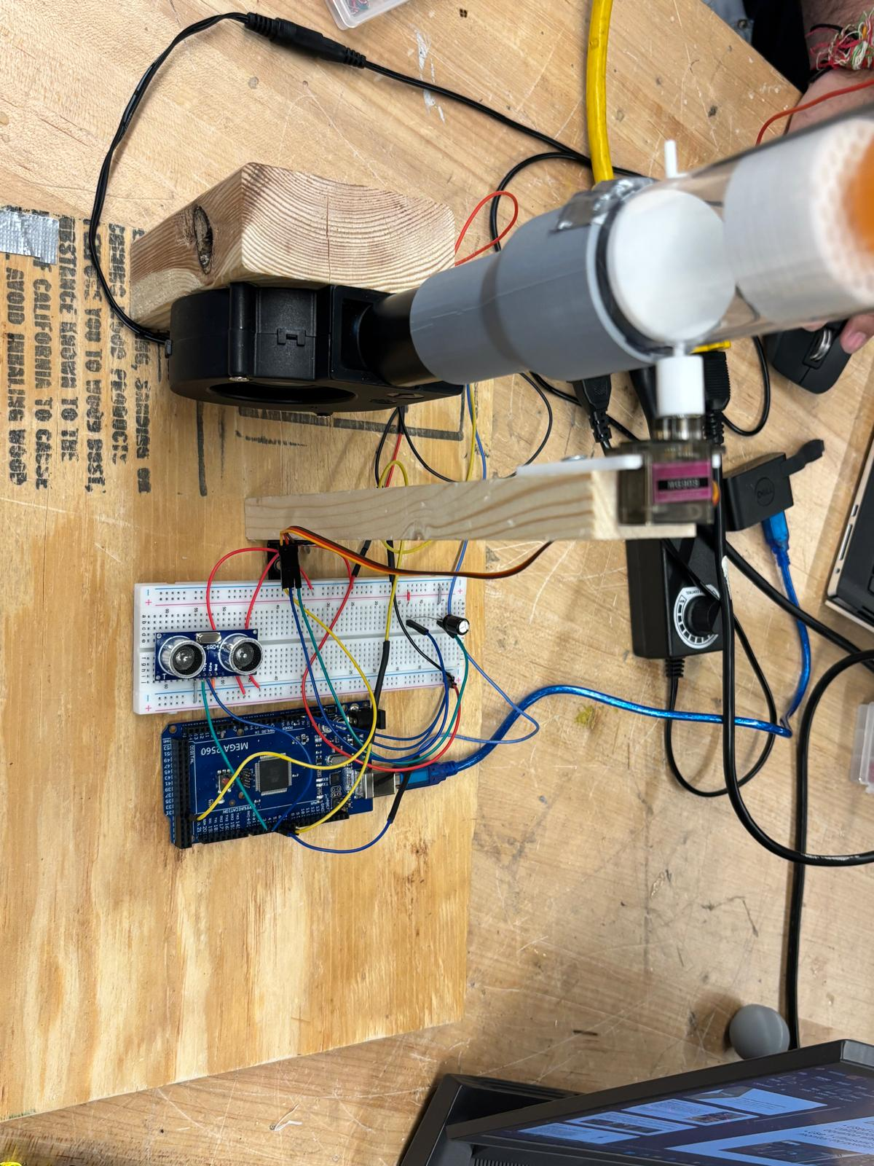
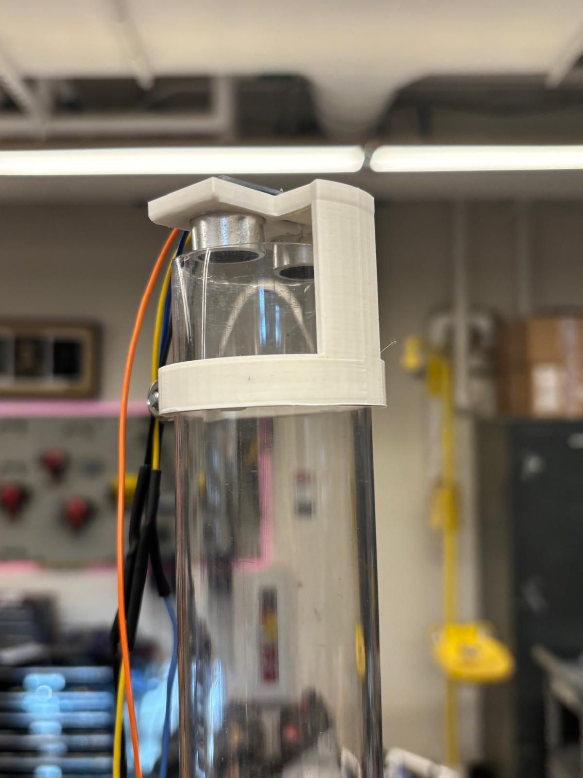
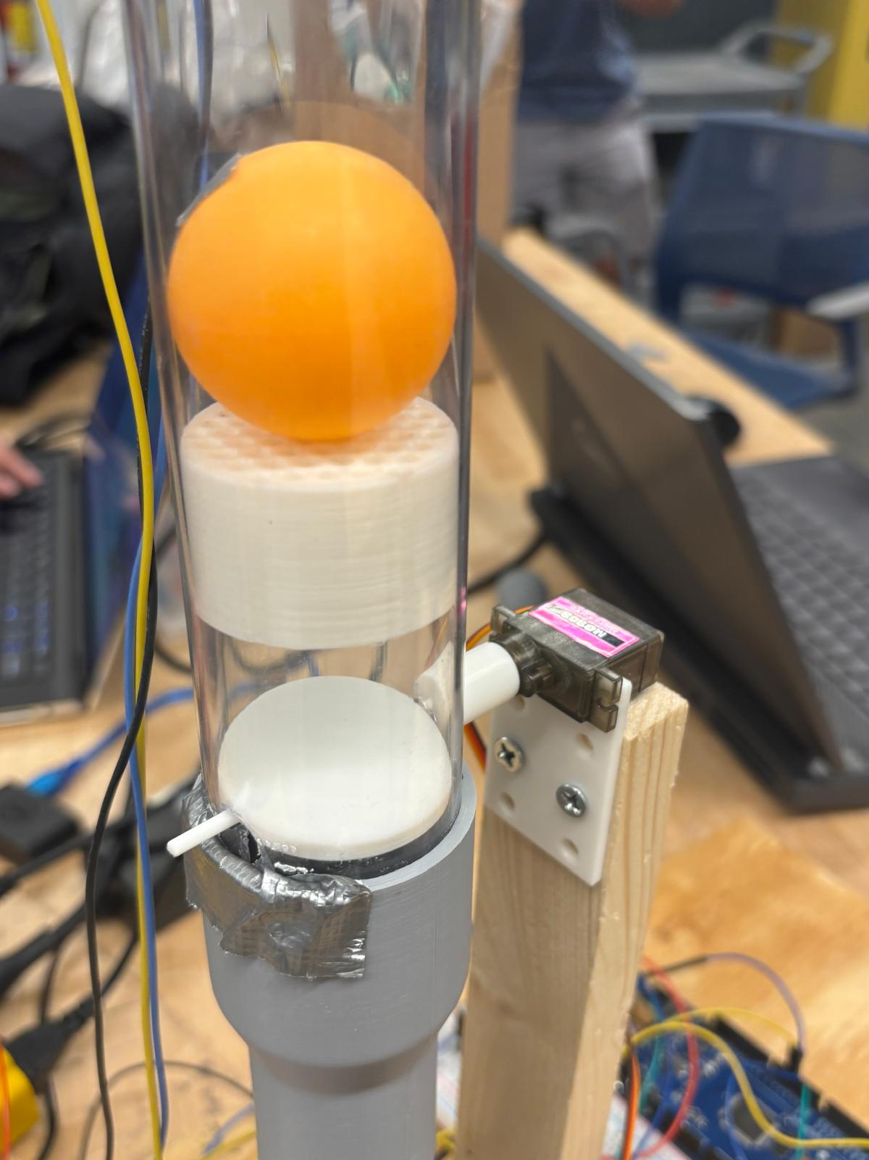
Design
Used HC-SR04 Ultrasonic sensors instead of IR sensor (required calibration curve function – challenging to determine)
Multiple Ultrasonic sensors used to measure ball and hand height
Attempted direct fan control – proved challenging with brushless DC motor
Flow Straightener
Servo Motor
Throttle
Ball Position Ultrasonic Sensor
Hand Position Ultrasonic Sensor
Brushless Fan

Slide 4
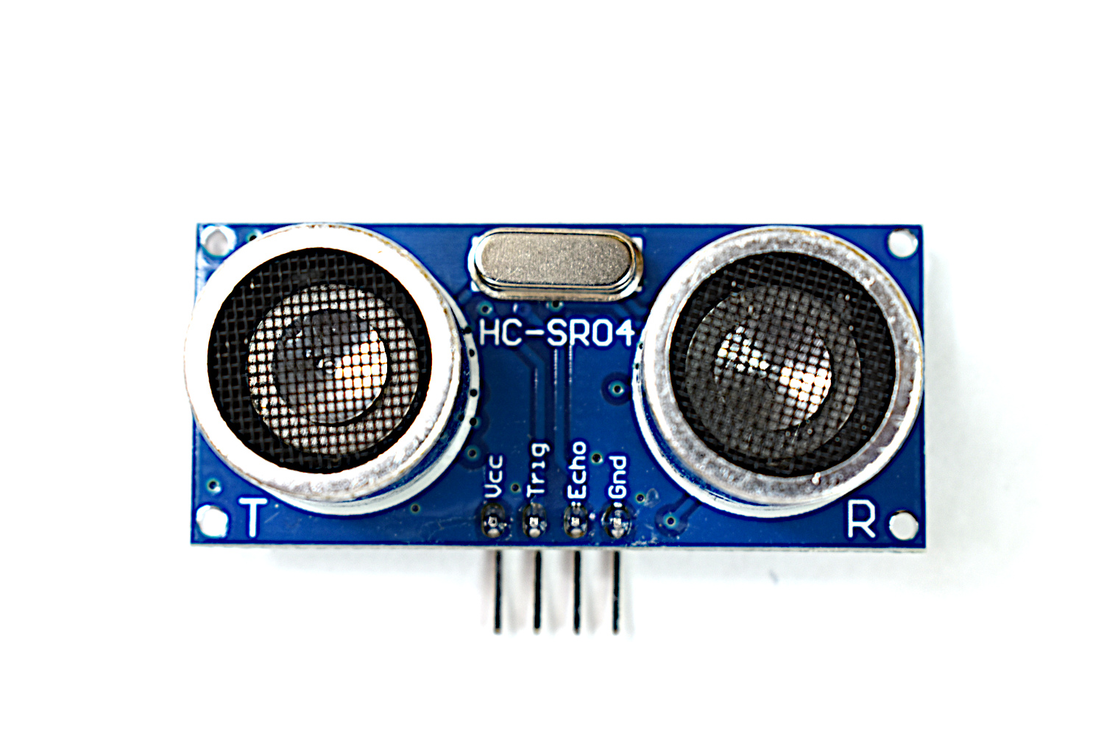
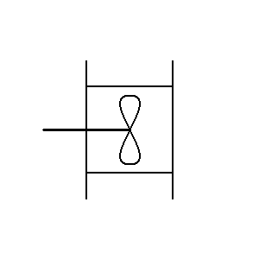
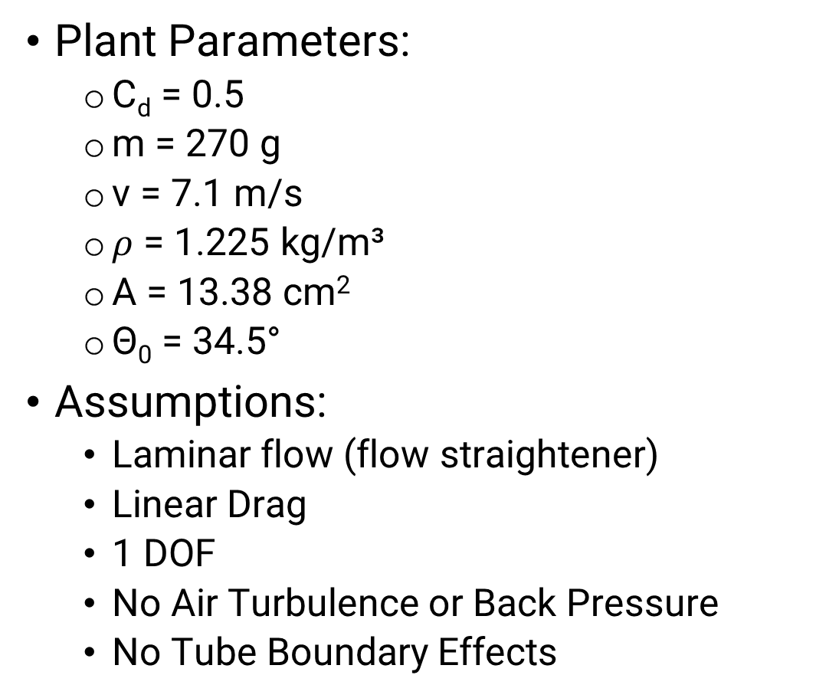
Model
$$G\left(s\right)=\frac{H\left(s\right)}{θ\left(s\right)}=\frac{\sin\left(θ_{0}\right){C_{d}v}^{2}ρA(1−\cos\left(θ_{0}\right))}{ms^{2}\left(1−\cos\left(θ_{0}\right)\right){\left(\cos\left(θ_{0}\right)−1\right)}^{3}+{s(C}_{d}vρA{\left(\cos\left(θ_{0}\right)−1\right)}^{3})}$$
Plant Parameters:
C_{d} = 0.5
m = 270 g
v = 7.1 m/s
$ρ$ = 1.225 kg/m³
A = 13.38 cm²
Θ₀ = 34.5°
Assumptions:
Laminar flow (flow straightener)
Linear Drag
1 DOF
No Air Turbulence or Back Pressure
No Tube Boundary Effects
Ultrasonic Sensor
Ball Position Targets
mg
Throttle
y
F_{drag}
Fan

Slide 5
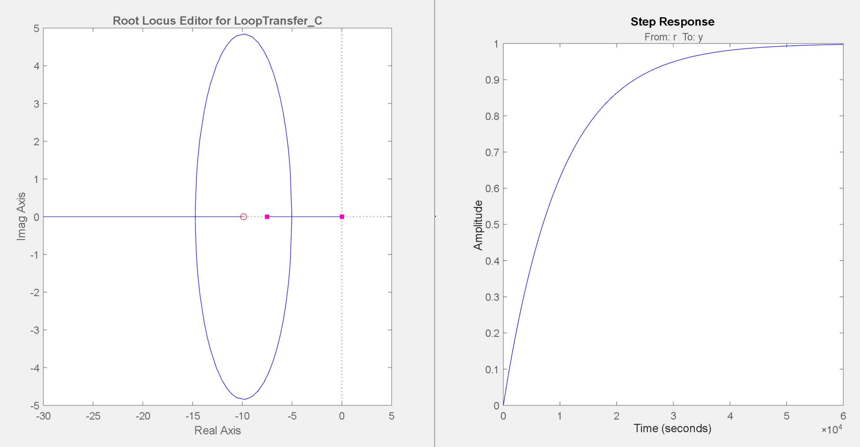
Controller Design
Root locus shows permanent OL stability regardless of gain
P, PD, PID are all valid controllers for this system
Controller Metrics (in order of importance):
Minimize Overshoot
Minimize Steady State Error
Minimize Oscillations
Decrease Rise Time

Slide 6
Control Design Block Diagram
P
Desired Height
I
1/s
System
+
Actual Height
D
d/dt

Slide 7
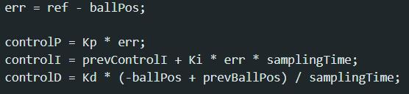
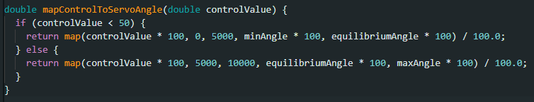
Results – Implementation
Arduino Mega 2560
Calculated distance error and scaled final controller signal via gains
Applied mapping function to provide input to servo motor
Minimum vs Equilibrium angle

Slide 8
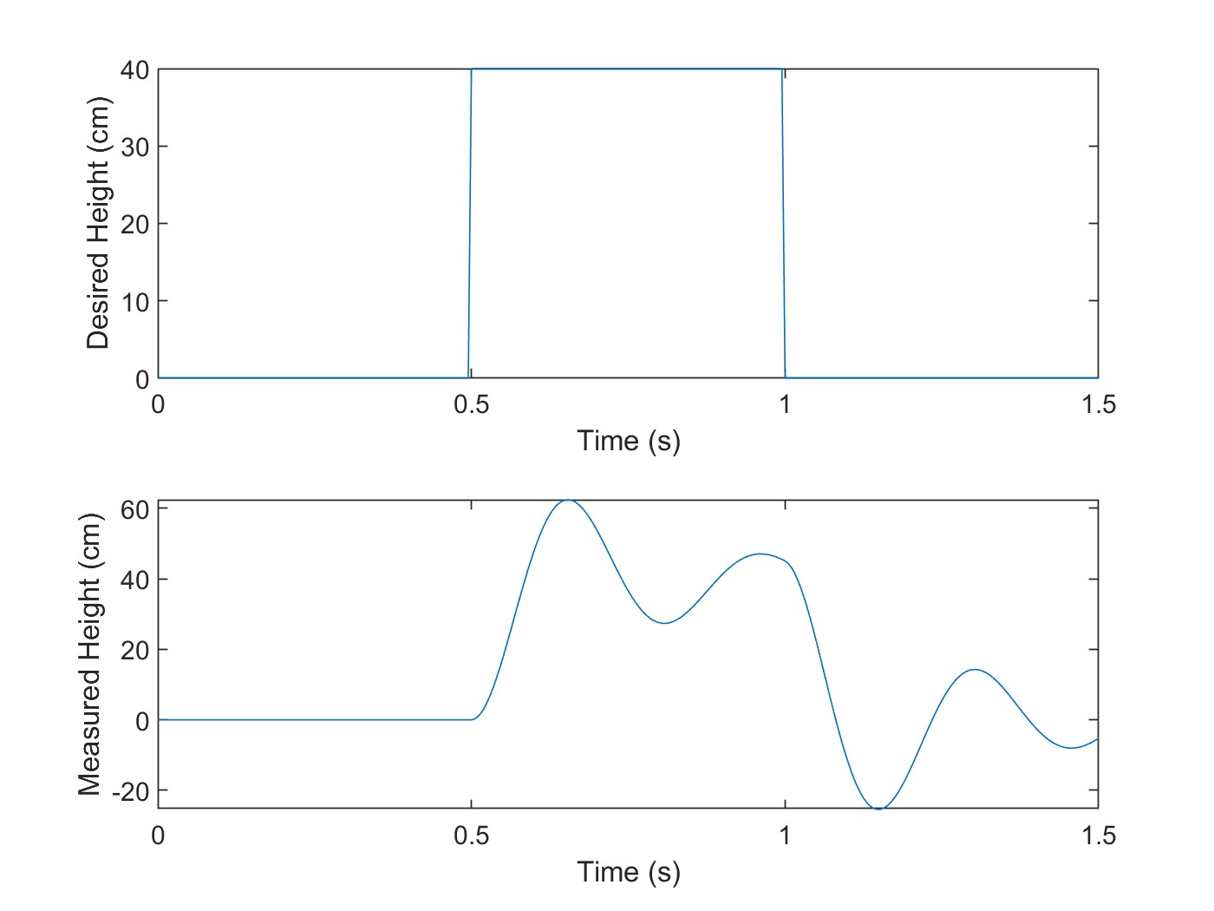
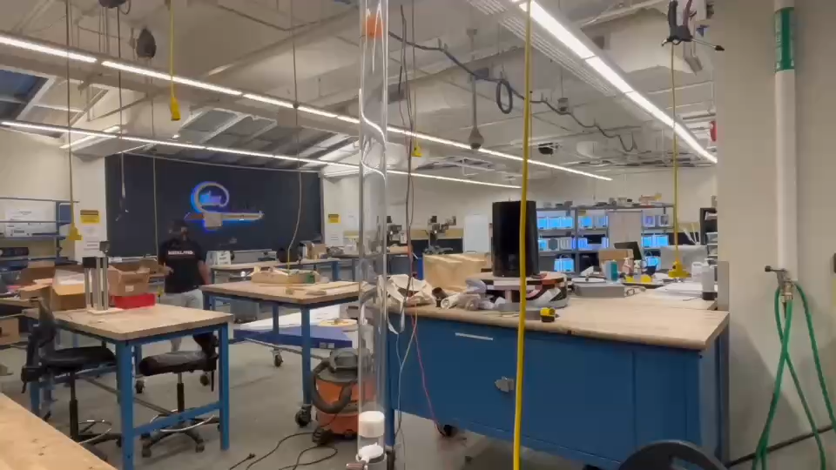
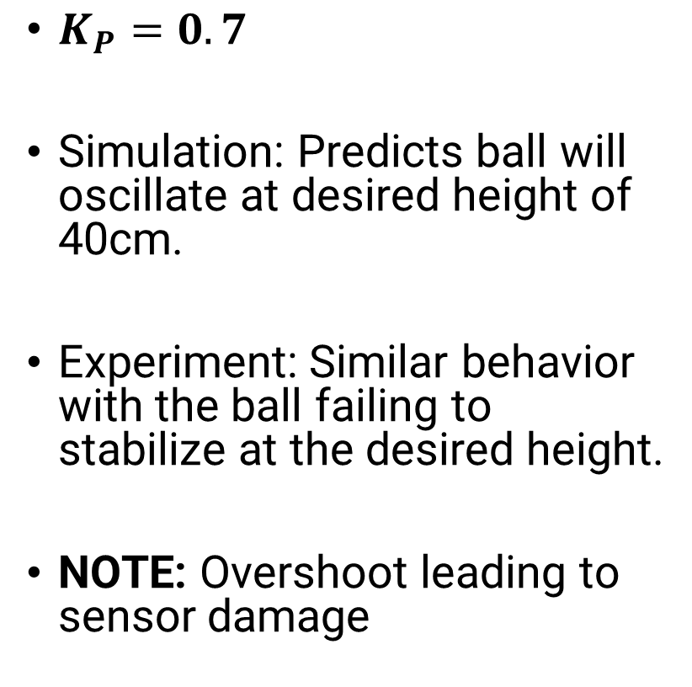
Results – P Controller
$K_{P}=0.7$
Simulation: Predicts ball will oscillate at desired height of 40cm.
Experiment: Similar behavior with the ball failing to stabilize at the desired height.
NOTE: Overshoot leading to sensor damage

Slide 9
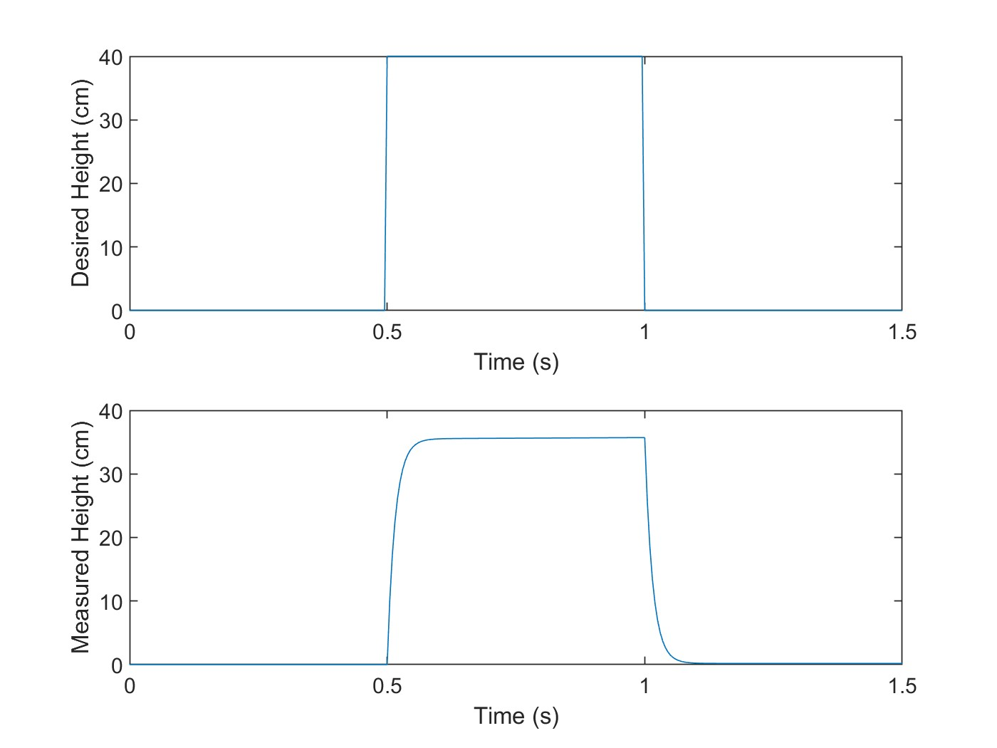
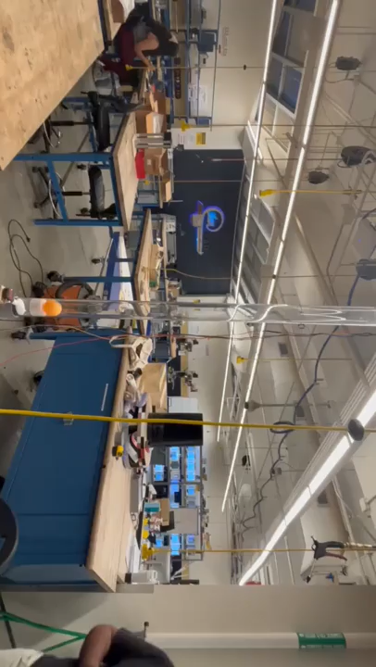
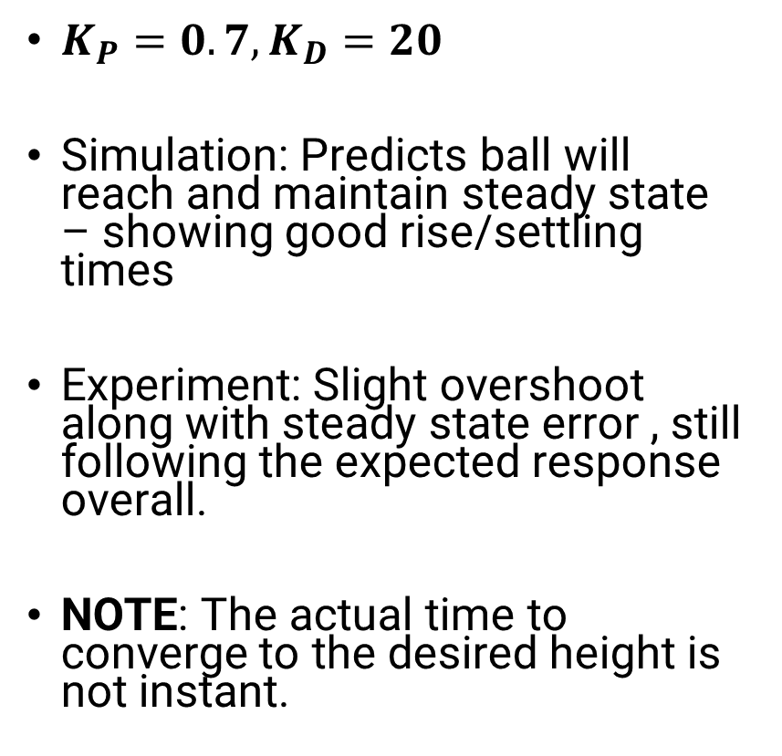
Results – PD Controller
$K_{P}=0.7, K_{D}=20$
Simulation: Predicts ball will reach and maintain steady state – showing good rise/settling times
Experiment: Slight overshoot along with steady state error , still following the expected response overall.
NOTE: The actual time to converge to the desired height is not instant.

Slide 10
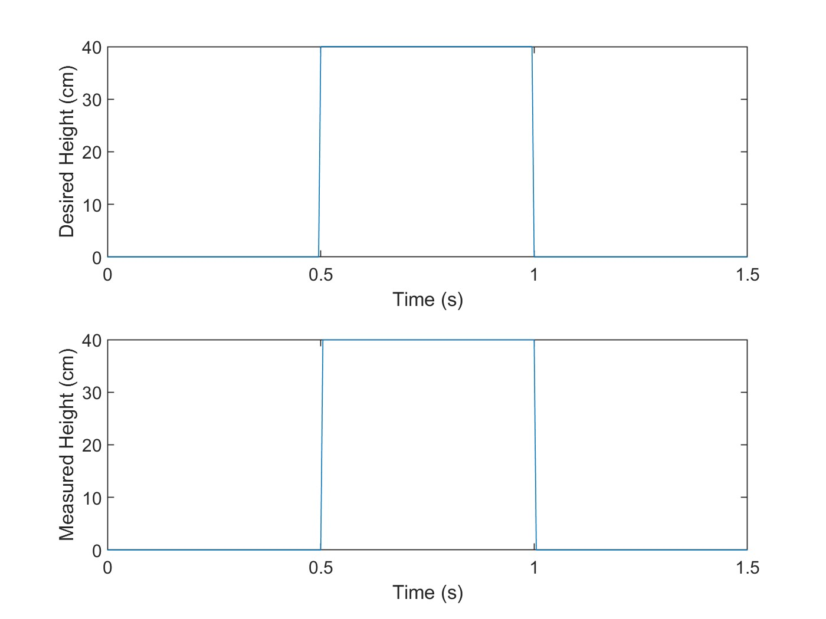
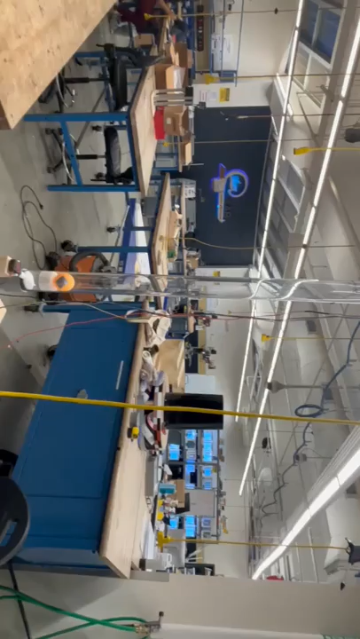
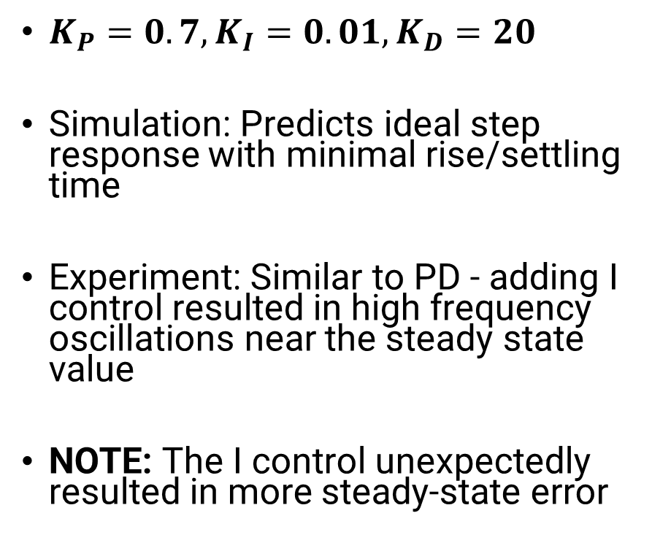
Results – PID Controller
$K_{P}=0.7, K_{I}=0.01, K_{D}=20$
Simulation: Predicts ideal step response with minimal rise/settling time
Experiment: Similar to PD - adding I control resulted in high frequency oscillations near the steady state value
NOTE: The I control unexpectedly resulted in more steady-state error

Slide 11
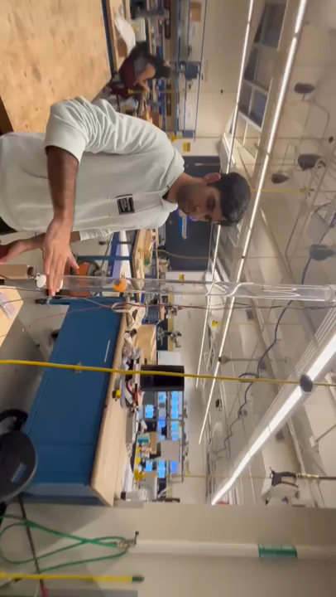
Final Implementation Video

Slide 12



Conclusion
The ball’s height can be controlled and be set to any position in the tube.
PD controller worked best whereas PID and P were not optimal.
IR sensor didn’t work well due to limited range and curve fitting.
Controlling brushless DC motor speed did not work well – operating principle
Filtering input signals may improve performance
In the future, spend more time in the modeling phase to avoid spending more time on tuning.
Acknowledgements: Professor Mazumdar, Idea Lab, Professor Ueda

Slide 13
References
[1] Tootchi, Amirreza & Amirkhani, Saeed & Chaibakhsh, Ali. (2019). Modeling and Control of an Air Levitation Ball and Pipe Laboratory Setup. 10.1109/ICRoM48714.2019.9071827.
[2] Caldeira, André & Rech, Charles & Maidana, Cristiano & Venturini, Simone & Pedra, Antônio. (2023). Feedback control applied to a low cost ball-in-tube air levitation plant. Ciência e Natura. 45. e84132. 10.5902/2179460X84132.
[3] Al Tahtawi, Adnan. (2018). Kalman Filter Algorithm Design for HC-SR04 Ultrasonic Sensor Data Acquisition System. IJITEE (International Journal of Information Technology and Electrical Engineering). 2. 10.22146/ijitee.36646.
[4] Tkáčik, T., Tkáčik, M., Jadlovská, S., & Jadlovská, A. (2021). Design of Aerodynamic Ball Levitation Laboratory Plant. Processes, 9(11), 1950. https://doi.org/10.3390/pr9111950
[5] Speed Control Analysis of Brushless DC Motor Using PI, PID and Fuzzy-PI Controllers - Scientific Figure on ResearchGate. Available from: https://www.researchgate.net/figure/Block-diagram-of-PID-controller-8-This-controller-has-0-steady-state-error-no_fig3_364173976 [accessed 16 Apr 2025]

Slide 14
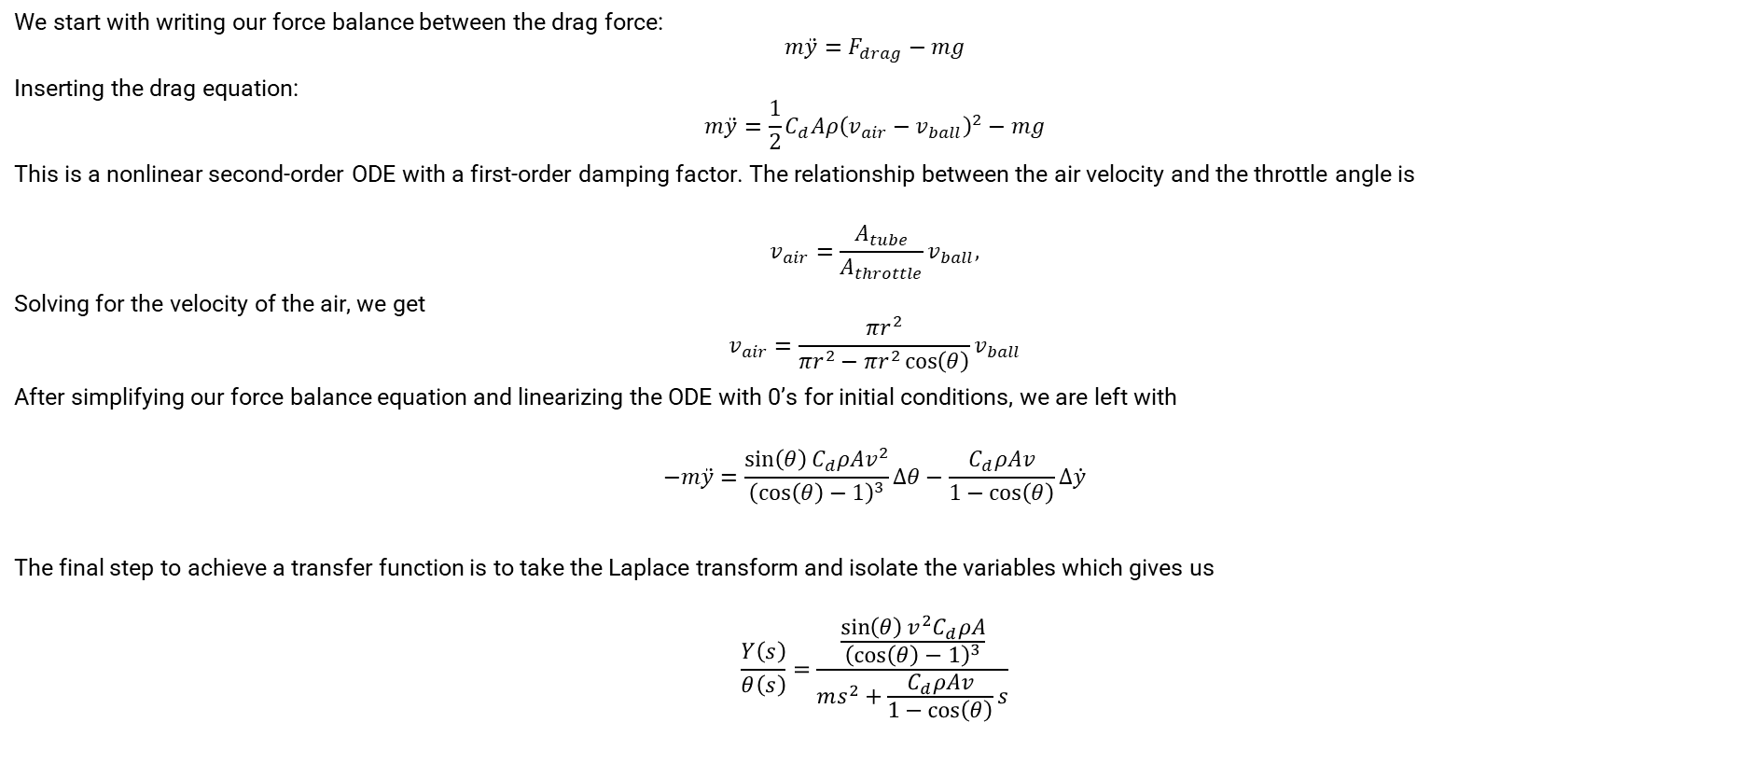
Appendix A: Model Derivation
We start with writing our force balance between the drag force:
$$m\ddot{y}=F_{drag}−mg$$
Inserting the drag equation:
$$m\ddot{y}=\frac{1}{2}C_{d}Aρ{\left(v_{air}−v_{ball}\right)}^{2}−mg$$
This is a nonlinear second-order ODE with a first-order damping factor. The relationship between the air velocity and the throttle angle is
$$v_{air}=\frac{A_{tube}}{A_{throttle}}v_{ball},$$
Solving for the velocity of the air, we get
$$v_{air}=\frac{πr^{2}}{{πr}^{2}−{πr}^{2}\cos\left(θ\right)}v_{ball}$$
After simplifying our force balance equation and linearizing the ODE with 0’s for initial conditions, we are left with
$$−m\ddot{y}=\frac{\sin\left(θ\right){C_{d}ρAv}^{2}}{{\left(\cos\left(θ\right)−1\right)}^{3}}∆θ−\frac{C_{d}ρAv}{1−\cos\left(θ\right)}∆\dot{y}$$
The final step to achieve a transfer function is to take the Laplace transform and isolate the variables which gives us
$$\frac{Y\left(s\right)}{θ\left(s\right)}=\frac{\frac{\sin\left(θ\right)v^{2}C_{d}ρA}{{\left(\cos\left(θ\right)−1\right)}^{3}}}{ms^{2}+\frac{C_{d}ρAv}{1−\cos\left(θ\right)}s}$$

